Slide 1

Recommendation Systems
&
Model Architecture

Slide 2
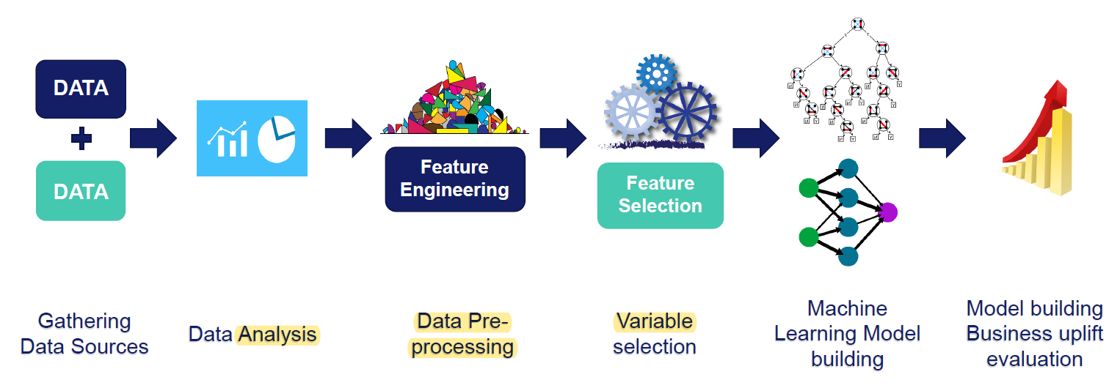
Machine Learning Pipeline: Overview Model

Slide 3
Machine Learning Pipeline: Overview Model
Data Gathering – We have used a mobile dataset from various data sources. Dataset - Mobiles.csv
Data Analysis – We have performed various statistical analysis on the dataset.
Pre Processing (Feature Engineering) –
Missing Values Analysis
Labels in Categorical Values
Distributions – Gaussian vs Skewed.
Outliers Identification
Feature Selection – Used
Constant Variable
Duplications
Correlations

Slide 4
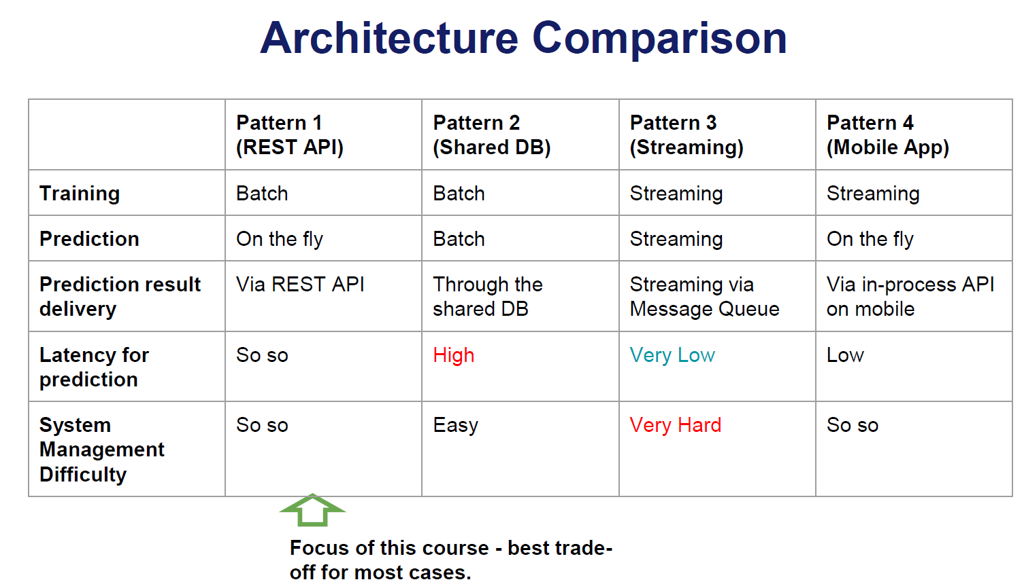
General ML System Architecture
General ML Architectures
1.Train by batch, predict on the fly, serve via REST API
2.Train by batch, predict by batch, serve through a shared database
3.Train, predict by streaming
4.Train by batch, predict on mobile (or other client)

Slide 5
ML System Architecture
Machine learning in production requires multiple different components in order to work:
Infrastructure
Applications
Data
Documentation
Configuration
Together, these parts form the overall system. These software components are arranged for interactions between them.
Planning → Architecture Design → Responsibilities → Cooperation → Execution

Slide 6
Key Principles for ML System Architecture
Reproducibility: Have the ability to replicate a given ML prediction
Automation: Retrain, update and deploy models as part of an automated pipeline
Extensibility: Have the ability to easily add and update models.
Modularity: Preprocessing/feature engineering code used in training should be organized into clear pipelines
Scalability: Ability to serve model predictions to large numbers of customers (within time constraints)
Testing: Test variation between model versions

Slide 7
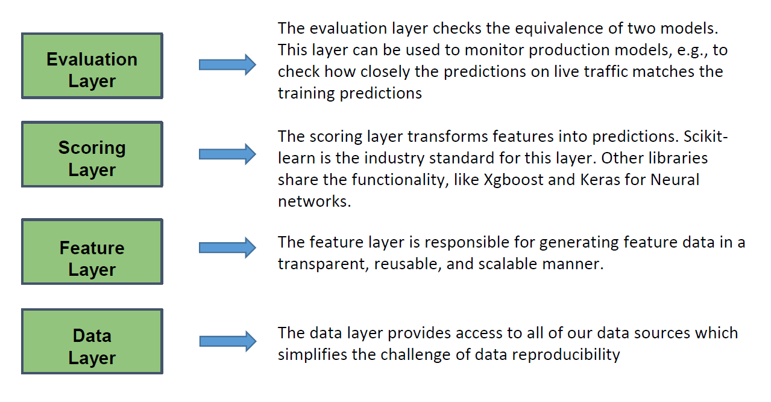
Architecture Component Breakdown
Train by batch, predict on the fly
High Level Architecture:

Slide 8
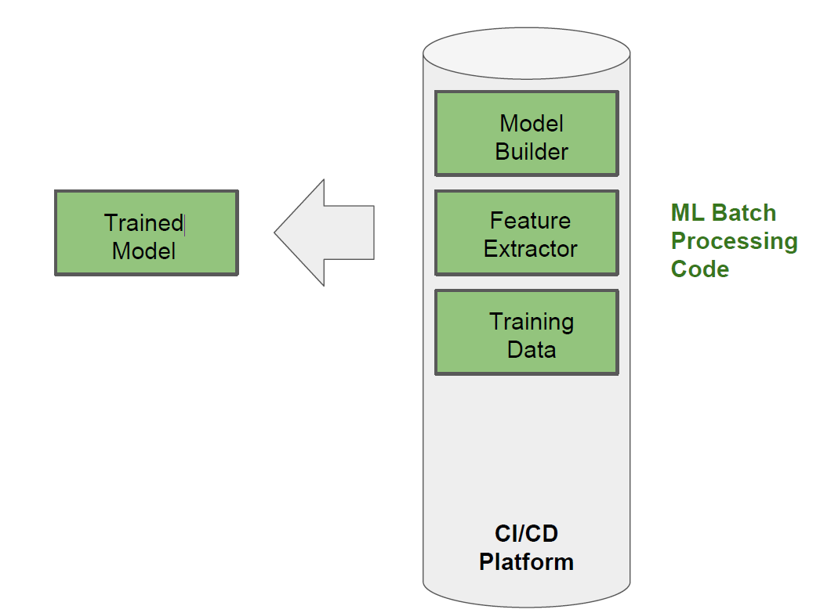
Breakdown: Training Phase

Slide 9
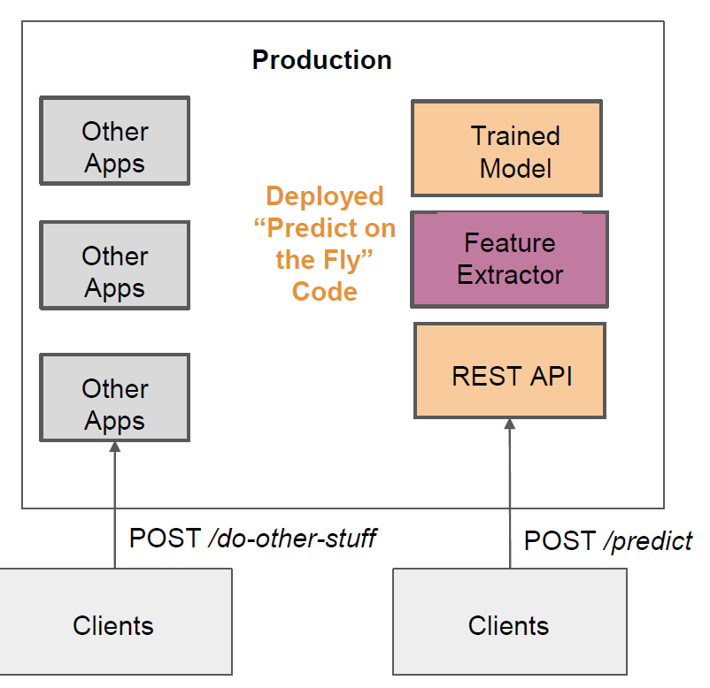
Breakdown: Prediction Phase

Slide 10
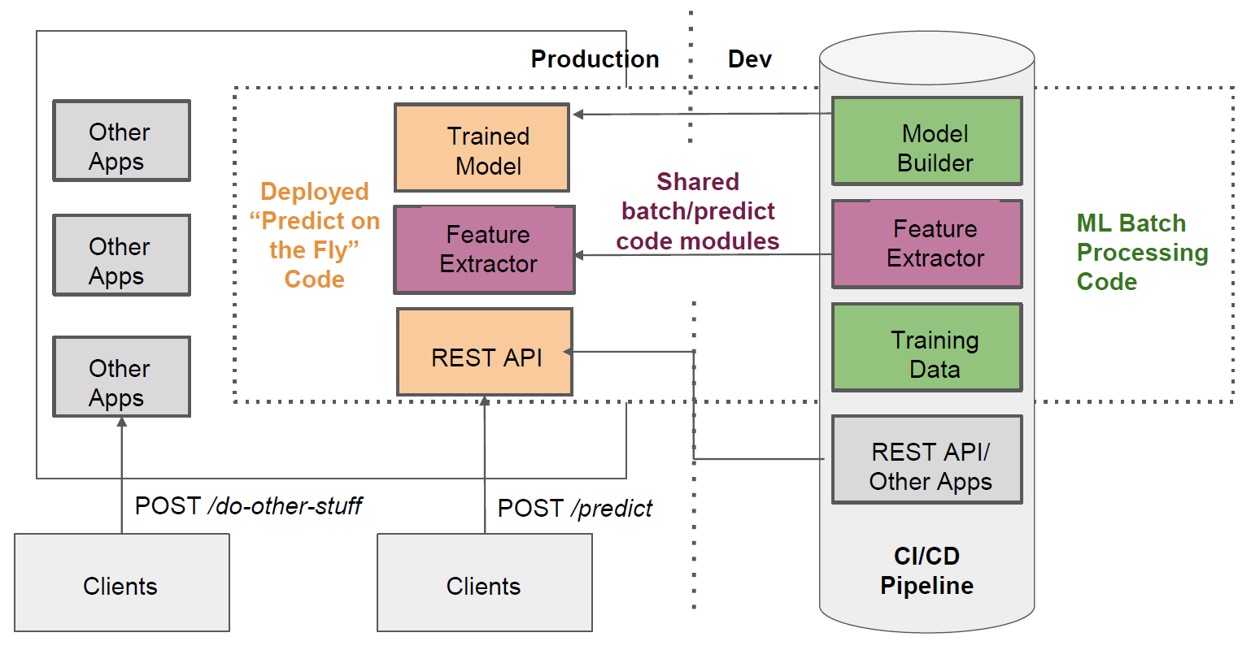
Diagram: Train by batch, predict on the fly, serve via REST API

Slide 11
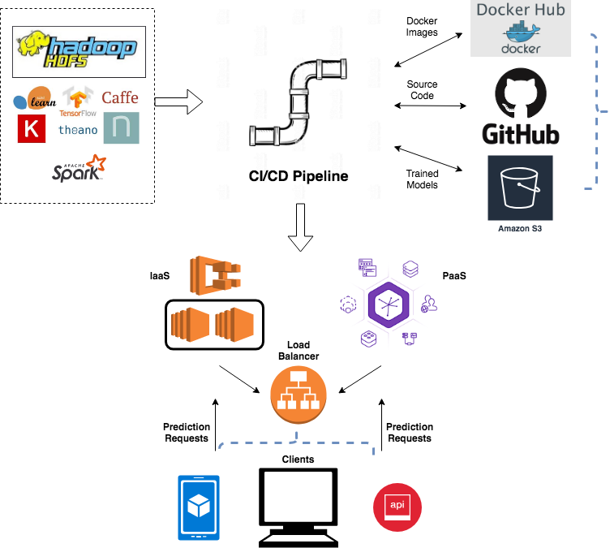
Syetem Diagram

Slide 12
Writing Production Code for ML Deployment

Slide 13
REST API?
A Representational State Transfer (REST)
Application Programming Interface (API):
Serving our model via REST API allows us to:
Serve predictions on the fly to multiple clients
Decouple our model development from the client facing layer
Potentially combine multiple models at different API endpoints
Scale by adding more instances of the application behind a load balancer

Slide 14
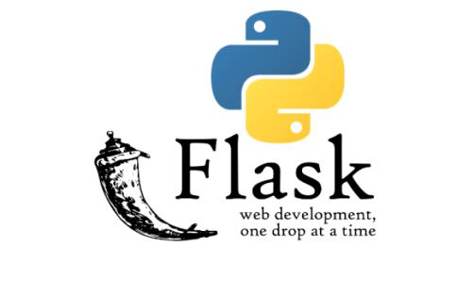
Flask Overview
We will build our API using the flask micro framework:
●Popular choice for Python microservices
●Lightweight and flexible
●Alternatives include: Django, Pyramid, Bottle, Sanic, Tornado, API Star amongst many others.

Slide 15
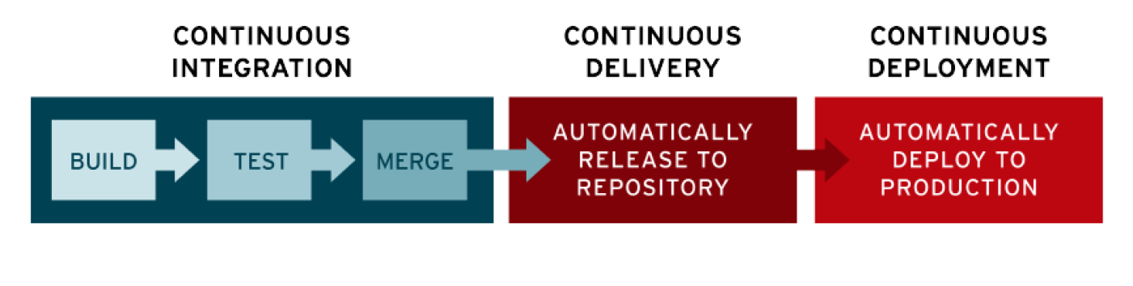
Continuous Integration and Deployment (CI/CD)
What is CI/CD?
“Automating the stages of app development”

Slide 16

Why Does This Matter?
Testing and deploying our applications according to the CI/CD method means:
The system in an “always releasable” state
Faster, regular release cycles
Building and testing is automated
Delivery and deployments are automated (at least to some extent)
Visibility across the company (and audit log)
Various CI/CD Platforms:
CircleCi, Jenkins, Travis CI, Bamboo, Gitlab CI, Team City, Etc.

Slide 17
Differential Tests?
A type of test that compares the differences in execution from one system version to the next when
the inputs are the same.
Sometimes called “back-to-back” testing
Very useful for detecting machine learning system errors that do not raise exceptions.
Tuning them is a balancing act (depends on business requirements).
Can prevent very painful mistakes that are not detected for long periods of time.
Advantages:-
Differential tests can protect you from costly mistakes.
Run them like any other tests in your CI pipeline
Easiest with Docker

Slide 18

Other Tests to Consider
If a prediction and/or training speed is a key metric for you, consider implementing benchmark tests to compare the speed of functions from one system version to the next.
A great framework for doing this is pytest-benchmark: https://github.com/ionelmc/pytest-benchmark
In complex microservice environments, you may also wish to consider API contract testing.
A nice framework for this is Pact: https://docs.pact.io/

Slide 19

Deploying to a Platform as a Service (Heroku)
What is a Platform as a Service (PaaS)?
“A cloud-based service that provides a platform allowing customers to develop, run, and manage applications without the complexity of building and maintaining the infrastructure typically associated with developing and launching an app.”
PaaS Providers
AWS Elastic Beanstalk
Windows Azure
Heroku
Force.com
Google App Engine
Apache Stratos
OpenShift
PythonAnywhere
...and many more.

Slide 20
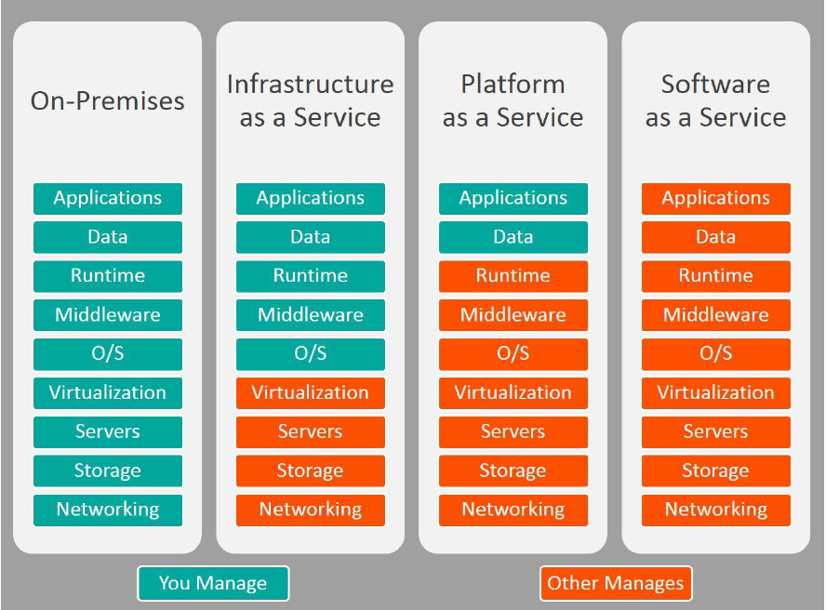
Understanding the Range of Possibilities

Slide 21
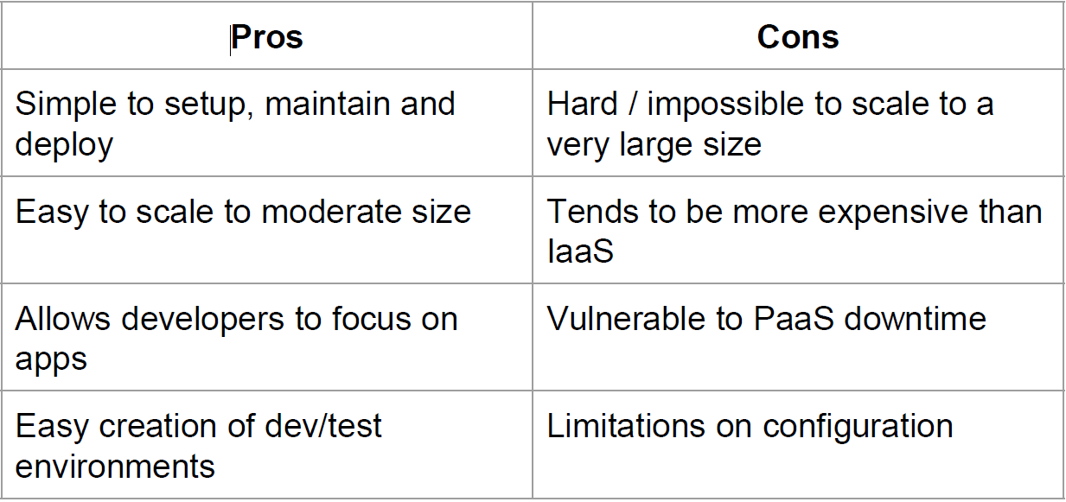
PaaS Pros and Cons

Slide 22
Key Learning Points
Integrate your deployments into your CI pipeline
Deployments can be easy!
Get used to checking deployments and logs -debugging in production is an important skill.
Heroku Scaling
On a paid plan, you can manually change the number of Heroku “dynos” to scale your app.
On Performance Tier Dynos, you can enable and configure autoscaling: https://devcenter.heroku.com/articles/scaling#autoscaling

Slide 23
Deploying with Containers (Docker)
What is a Container?
“A container is a standard unit of software that packages up code and all its dependencies so the application runs quickly and reliably from one computing environment to another.”
What is Docker?
●Put simply, Docker is a tool to make creating, deploying and running containers easy.
●Docker is open source
●Released in 2013
●A Docker container is a standardized unit of software development, containing everything that your software application needs to run: code, runtime, system tools, system libraries, etc.
●Containers are created from a read-only template called an image

Slide 24
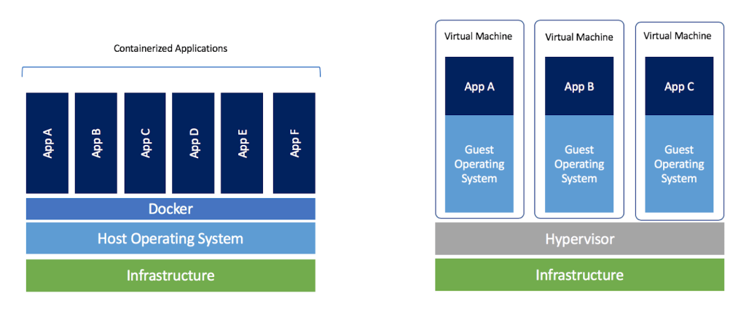
Containers vs. Virtual Machines

Slide 25
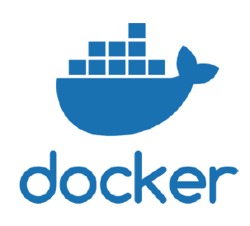
Why Use Containers?
●Reproducibility
●Isolation
●Simplicity of environment management (Great for making staging/UAT match production)
●Ease of continuous integration
●Much faster and more lightweight than a VM
●Container orchestration options (e.g. Kubernetes)
●Docker is the most popular tool for creating and running containers
https://hub.docker.com/

Slide 26
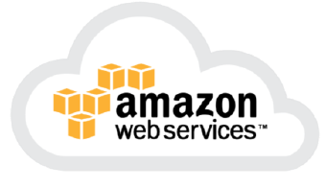
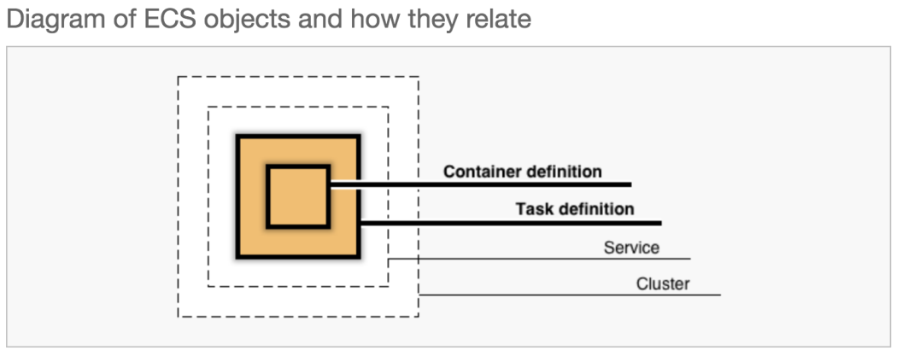
Deploying with IaaS (AWS ECS)
AWS Elastic Container Service (ECS)
“Amazon Elastic Container Service (Amazon ECS) is a highly scalable, fast, container management service that makes it easy to run, stop, and manage Docker containers on a cluster.”
ECS Components:

Slide 27
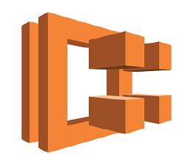
ECS Services
Amazon ECS allows you to run and maintain a specified number of instances of a task definition simultaneously in an Amazon ECS cluster. This is called a service.
If any of your tasks should fail or stop for any reason, the Amazon ECS service scheduler launches another instance of your task definition to replace it and maintain the desired count of tasks in the service depending on the scheduling strategy used.
ECS Cluster
An Amazon ECS cluster is a logical grouping of tasks or services.
Two main launch types: Fargate and EC2: https://docs.aws.amazon.com/AmazonECS/latest/developerguide/launch_types.html

Slide 28
IaaS Next Steps
Explore other AWS services: S3, Load Balancing, new ELK
Explore other IaaS Providers: MS Azure, Google Compute Engine
Explore other container orchestration engines (Kubernetes, Docker Swarm)

